Slide 1









ExpressionLearner
(AI-Assisted Chinese Language Expression
Practice Platform for Lower-Grade Students)
Presented by Team 08
Xuanhe Yang 2252709
Peiyu Duan 2251531
Tong Li 2251653
Fubin Chen 2253715

Slide 2


Part I
Overview

Slide 3




Overview
ExpressionLearner is a Java-based web project that integrates multiple AI interfaces, enabling users to create sentences based on pictures, with the system providing evaluations and corrections.
Target : lower-grade elementary students
Purpose : Improve their expressive abilities
Why Pictuer-Based ?
I . Visual Stimulation
II . Imagination Development
III . Contextual Learning
IV . Interactive Experience
Kid -friendly Design :
I . Easy to use
II . Child-friendly GUI
III . Provided pictures and
AI generated responses to children’s preferences

Slide 4



Design Approach
Tech Stack :
Frontend
Backend
Database
AI We may used :
[Speech Recognition] [NLP] [Sentiment Analysis] [Pattern Analysis] [GLM] [Conversational AI]

Slide 5


Part II
Functionalities
Features
Demo

Slide 6
Functionalities
I . JWT Security Authentication
using Spring Security with stateless JWT tokens for secure and convenient login
II. User Registration and Login
llow users to create accounts with input validation and encrypted password storage.
Enables secure access using username/password authentication and JWT token generation
III . User Profile Center
Provides user information overview and update capabilities, including task history tracking
IV . AI Feedback and Prompting
Evaluates students' storytelling on completeness, logic, and emotion, providing real-time feedback and word suggestions to improve language skills
V . Real-time Speech Recognition
Converts voice to text using WebSocket for real-time narration, enhancing task interactivity and engagement.
VI . Task Functionality
[Narrate stories based on images] [Receive mode-specific AI feedback] [Track task history and progress]

Slide 7
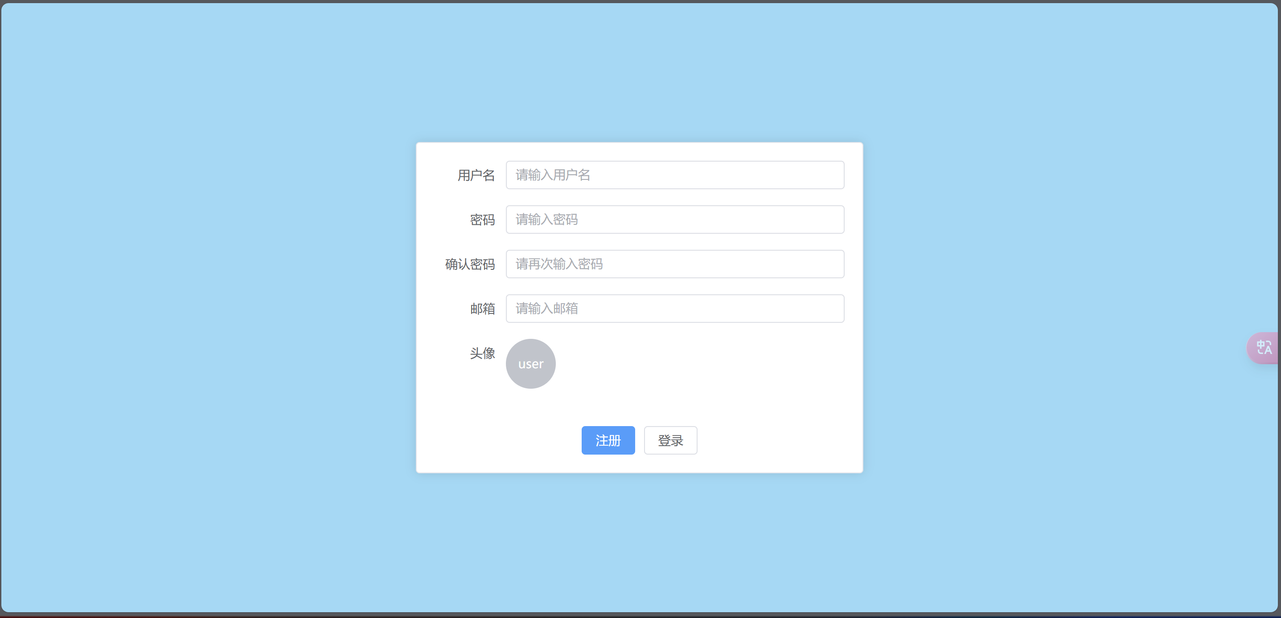
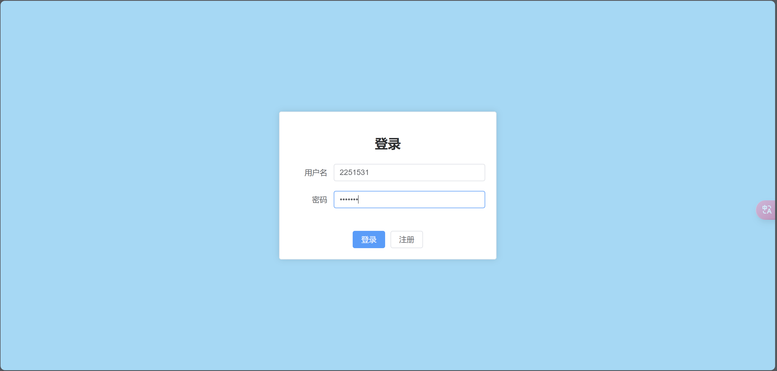
Features
Step-by-Step Registration&Login Process :
easily to get start!

Slide 8
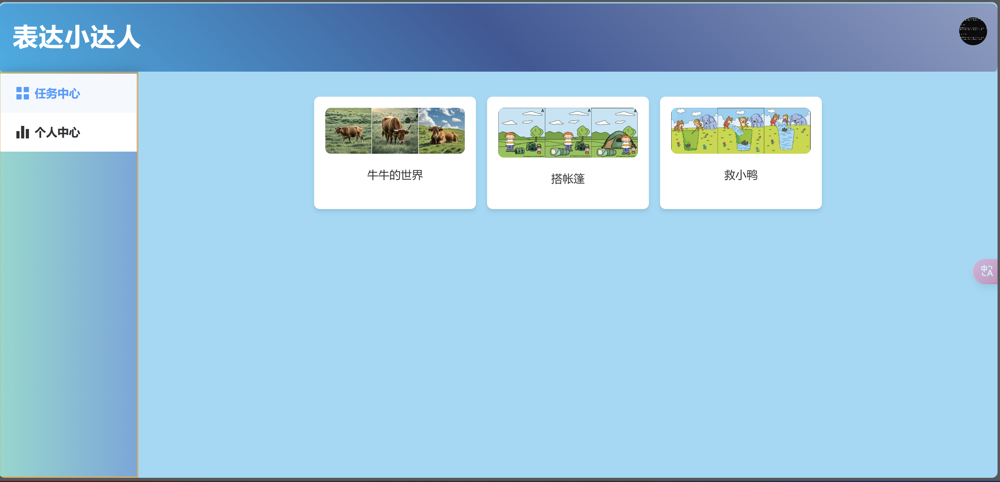
Features
Friendly GUI :
Simple and intuitive design for easy navigation and use

Slide 9
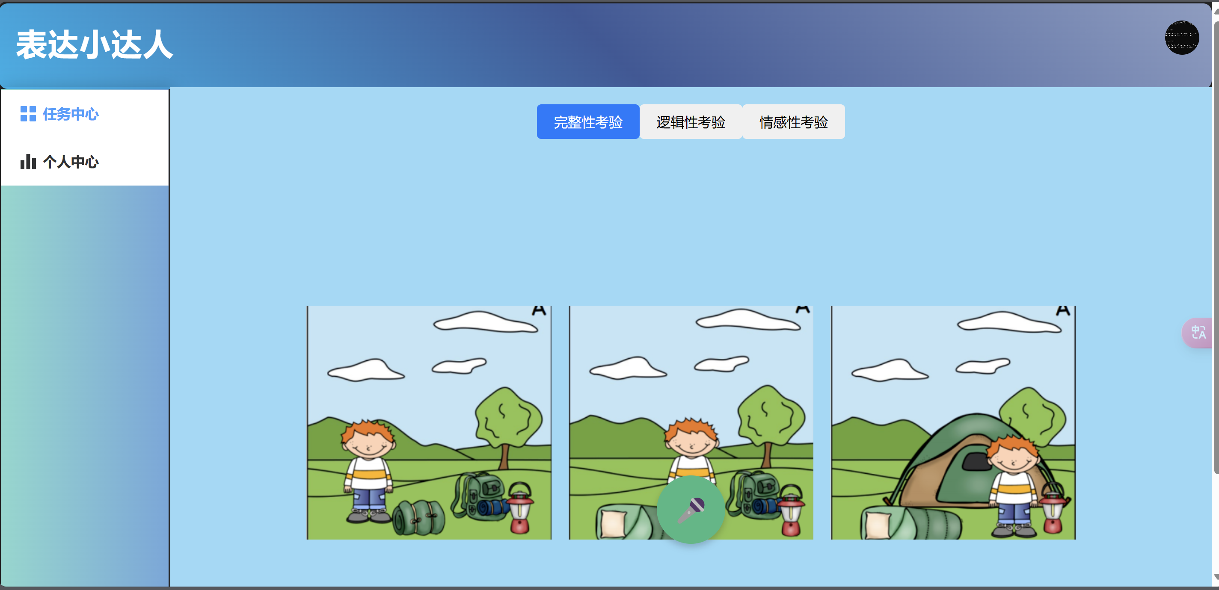
Features
Simple, Child-Oriented Picture Tasks :
Image-Based telling

Slide 10
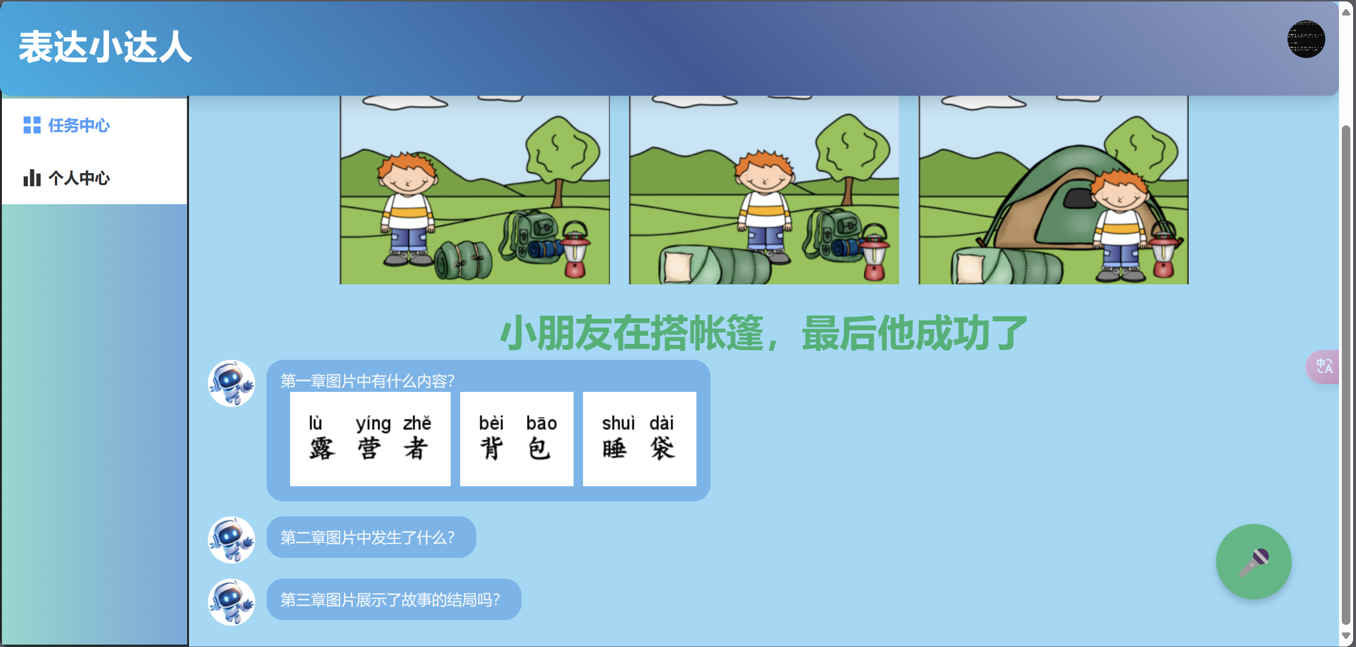
Features
Friendly AI Guiding :
Real-Time Speech-to-Text + Immediate AI Feedback

Slide 11
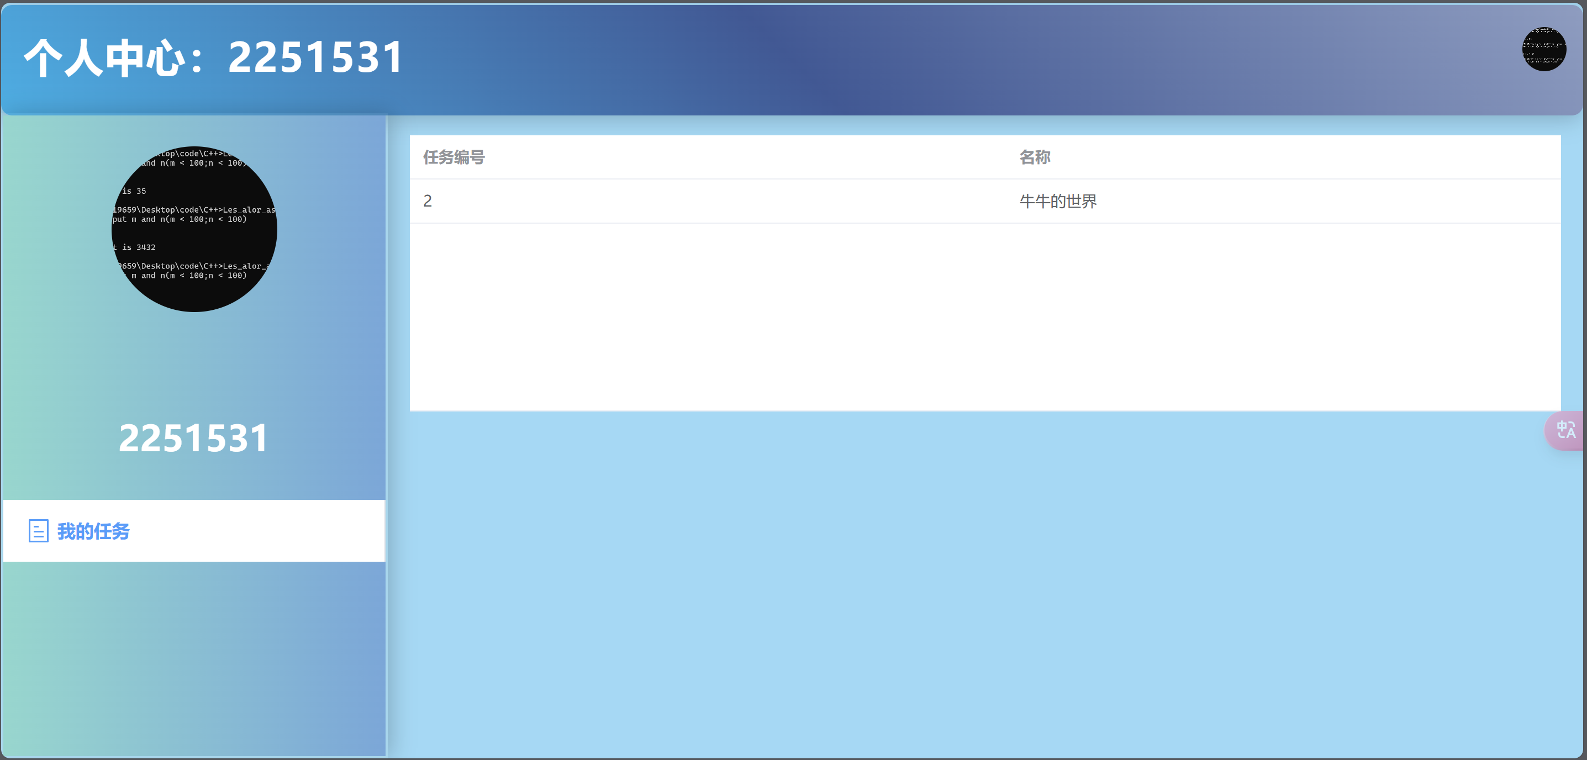
Features
Completed tasks history :
Task Review for Children

Slide 12

Part III
Design

Slide 13
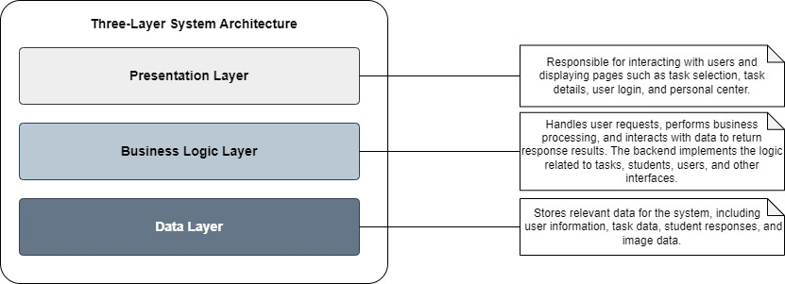
Architecture
Three-tier Architecture
Presentation Layer: Responsible for user interaction, displaying task selection, task details, user login, personal center, and other pages.
Business Logic Layer: Processes user requests, handles business logic and data interactions, returns response results. The backend implements interface logic related to tasks, students, and users
Data Layer: Stores system-related data, including user information, task data, student responses, and image data

Slide 14
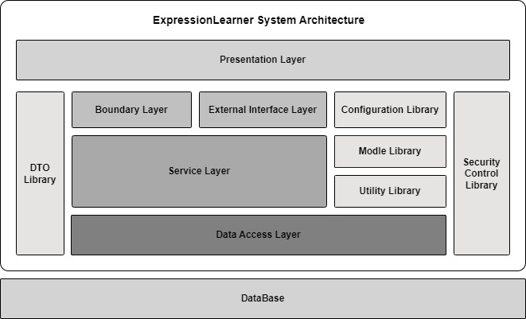
Architecture
Overall Architecture
Service Layer
core business logic layer, connecting presentation and data access layers
Data Access Layer
Handles database interactions
Boundary Layer
Manages interactions between external systems and internal components
External Interface Layer
Facilitates integration with third-party services or APIs
Utility & Configuration Libraries
Provides reusable tools and configurations for system operations
DTO & SC
supports efficient and clean data exchange
Ensures secure communication

Slide 15
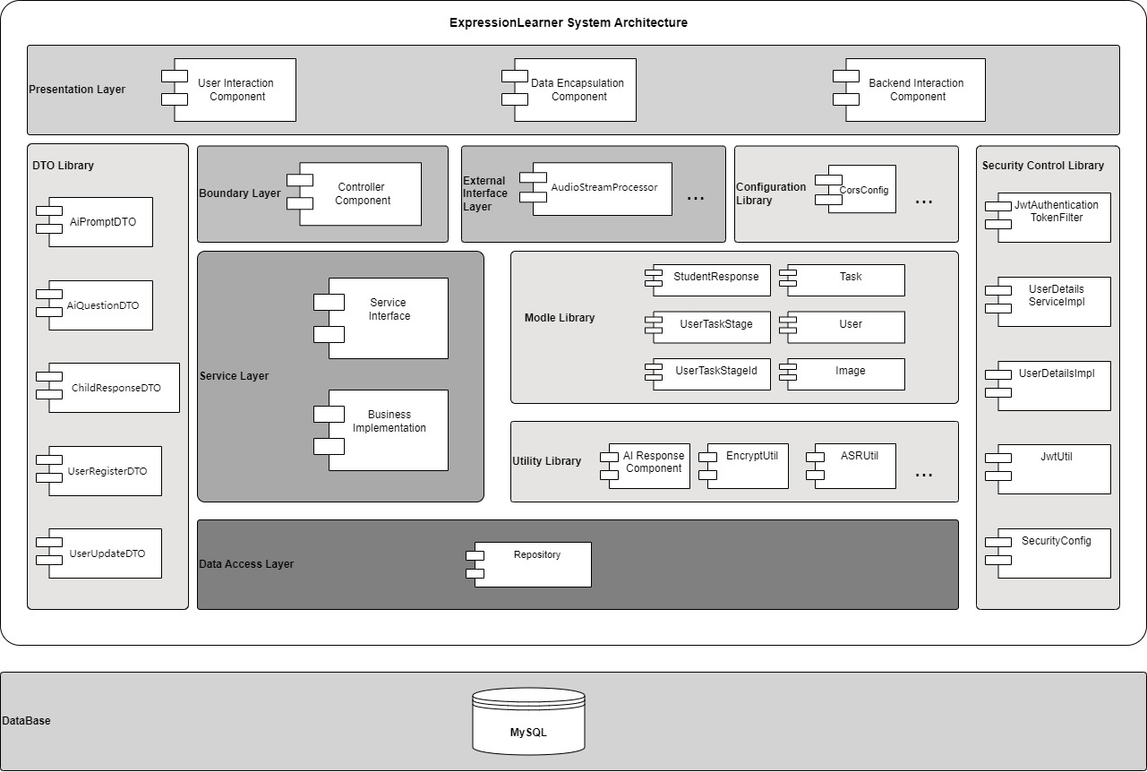
Architecture
Detailed Architecture
Next, we will provide introduction to the components and interfaces.

Slide 16
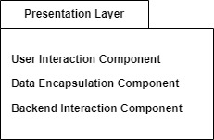
Components&Interfaces
Presentation Layer
Interaction Component
[Task Selection Page] [Task Details Page]
[Login Page] [Personal Center Page]
Data Encapsulation Component
Formats and encapsulates user input or system return data to meet backend interaction requirements. Encapsulates data into VOs for transmission and processing
Backend Interaction Components
Sends formatted data to the backend via API, where business logic processing occurs based on requirements and returns results

Slide 17
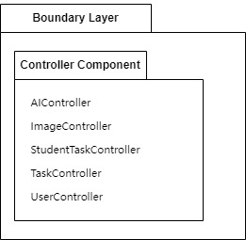
Components&Interfaces
Boundary Layer Controllers
AI Controller
Handles AI question requests and task session information retrieval, calls AiService
ImageController
Processes image uploads and task image queries, calls ImageService
StudentTaskController
Manages student task operations like homework submission, feedback retrieval, and grading, calls StudentTaskService
TaskController
Handles task retrieval, detail viewing, and creation, calls TaskService
UserController
Manages user operations like login, registration, and user information retrieval, calls UserService

Slide 18
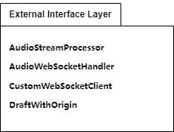
Components&Interfaces
External Interface Layer
AudioStreamProcessor
Processes audio stream data, sends audio data blocks to WebSocket clients
AudioWebSocketHandler
Handles WebSocket connections, establishes connections with voice recognition service.
CustomWebSocketClient
Custom WebSocket client for voice recognition service connection.
DraftWithOrigin
Custom WebSocket handshake protocol supporting cross-origin access

Slide 19
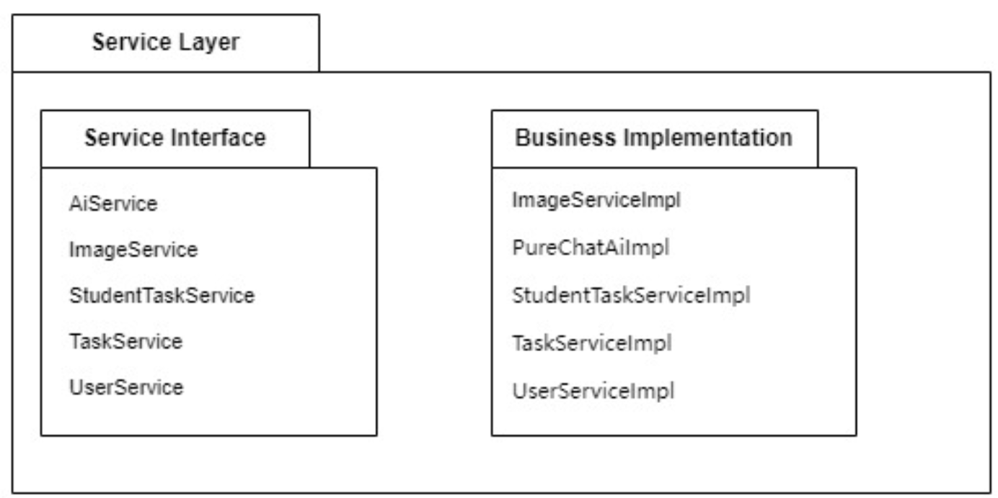
Components&Interfaces
Service Layer
Service interface
Business Implementation
AiService
Interacts with AI services
ImageServiceImpl
Implements image-related business logic
ImageService
Handles image operations
PureChatAiImpl
Implements AI question generation and feedback logic.
StudentTaskService
Processes student homework
StudentTaskServiceImpl
Implements student homework submission and grading logic.
TaskService
Handles task creation
and queries
TaskServiceImpl
Implements task creation and query logic.
UserService
Manages user login...
UserServiceImpl
Implements user management functionality

Slide 20
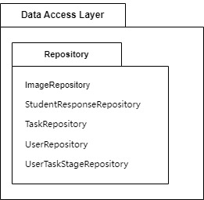
Components&Interfaces
Data Access Layer
ImageRepository
Stores and manages image data
StudentResponseRepository
Stores and manages student response information
TaskRepository
Stores and manages task information
UserRepository
Stores and manages user information
UserTaskStageRepository
Stores and manages user task stage information

Slide 21
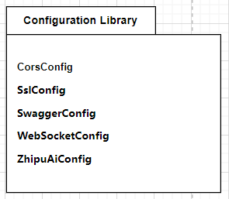
Components&Interfaces
Configuration Library
CorsConfig
Configures cross-origin resource sharing
SslConfig
Configures SSL context for WebSocket clients
SwaggerConfig
Configures Swagger for API documentation
WebSocketConfig
Configures WebSocket endpoints
ZhipuAiConfig
Configures Zhipu AI client connection

Slide 22
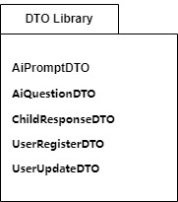
Components&Interfaces
DTO Library
AiPromptDTO
AI prompts and image links
AiQuestionDTO
User questions and prompts for AI service
ChildResponseDTO
Student responses and task stage data
UserRegisterDTO, UserUpdateDTO
User registration and update information

Slide 23
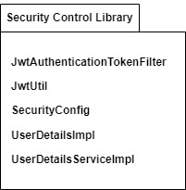
Components&Interfaces
Security Control Library
JwtAuthenticationTokenFilter
JWT verification filter
JwtUtil
JWT generation and parsing utility
SecurityConfig
Spring Security configuration with JWT
UserDetailsImpl
Custom user information implementation
UserDetailsServiceImpl
Custom user details service

Slide 24
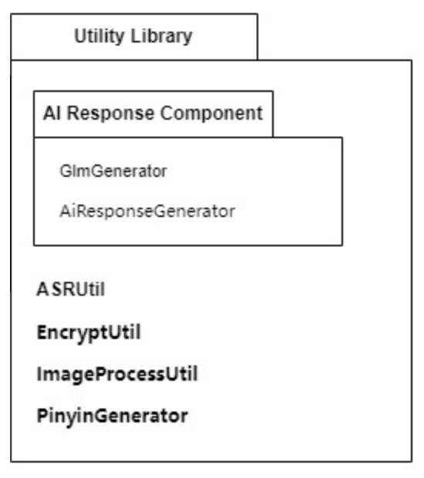
Components&Interfaces
Utility Library
GlmGenerator
Interacts with GLM model
AiResponseGenerator
AI response generation interface
ASRUtil
Processes voice recognition service parameters
EncryptUtil
Provides HMAC-SHA1 and MD5 encryption
ImageProcessUtil
Generates pinyin-annotated images
PinyinGenerator
Converts Chinese characters to pinyin

Slide 25
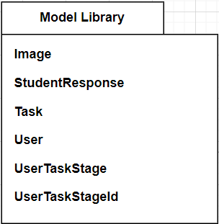
Components&Interfaces
Model Library
Image
Stores images required for tasks
StudentResponse
Stores student response information
Task
Stores task-related information
User
Stores user-related information
UserTaskStage
Records user’s current task and stage information
UserTaskStageId
Composite primary key including task id and user id

Slide 26
DataBase
Main tables
User
Stores user account information
StudentResponse
Stores student answers and feedback
Task
Stores detailed task information
UserTaskStage
Records user task stage information
Image
Stores task-related images

Slide 27
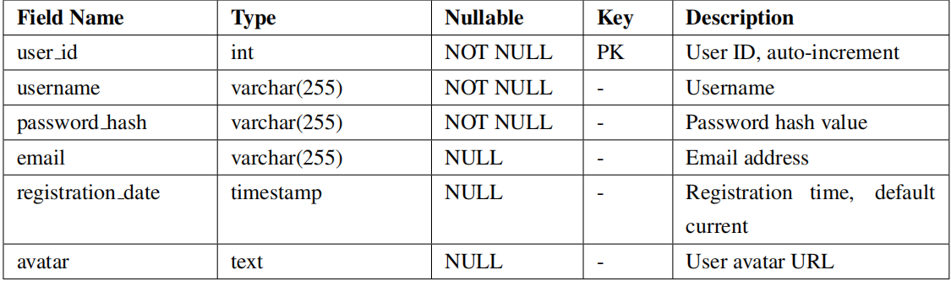
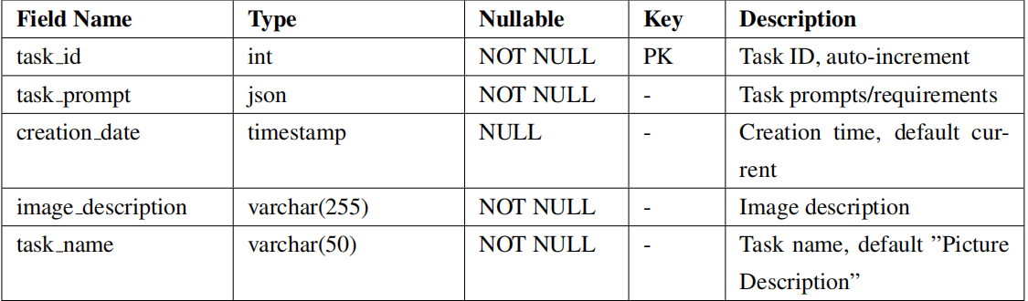
DataBase detailed
User Table
Task Table

Slide 28
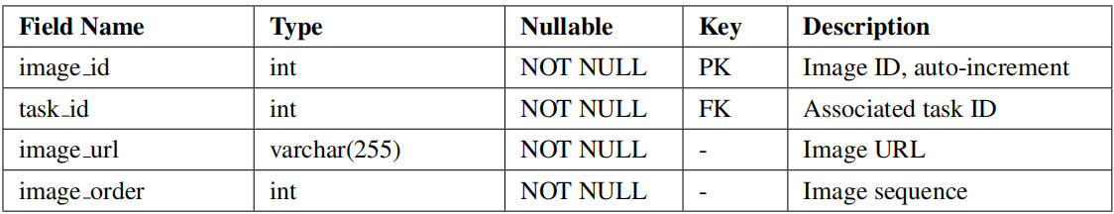
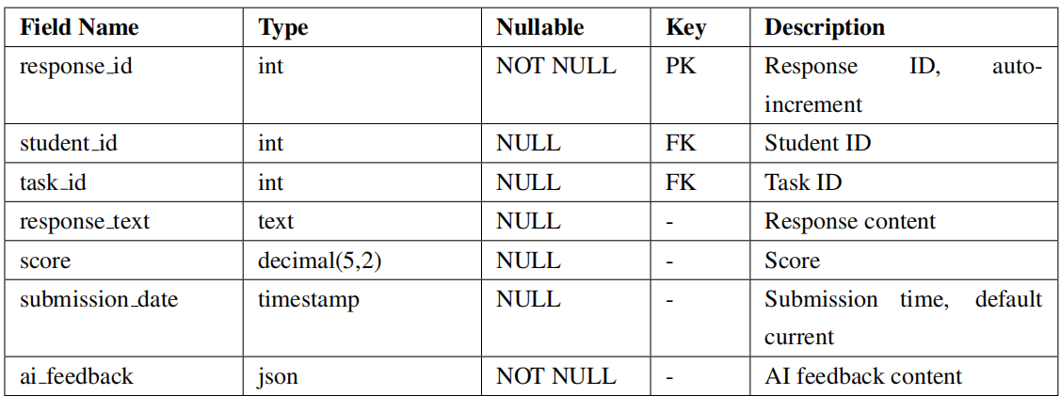
DataBase detailed
Image Table
StudentResponse Table

Slide 29
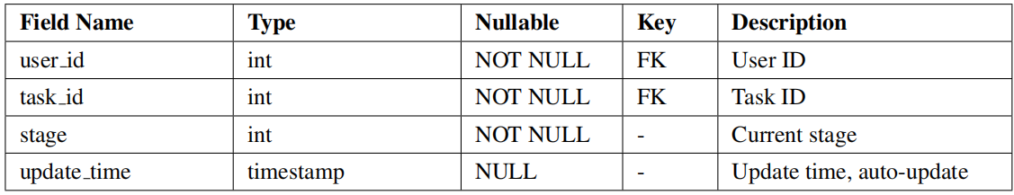
DataBase detailed
UserTaskStages Table

Slide 30

Part IV
Team Collaboration

Slide 31


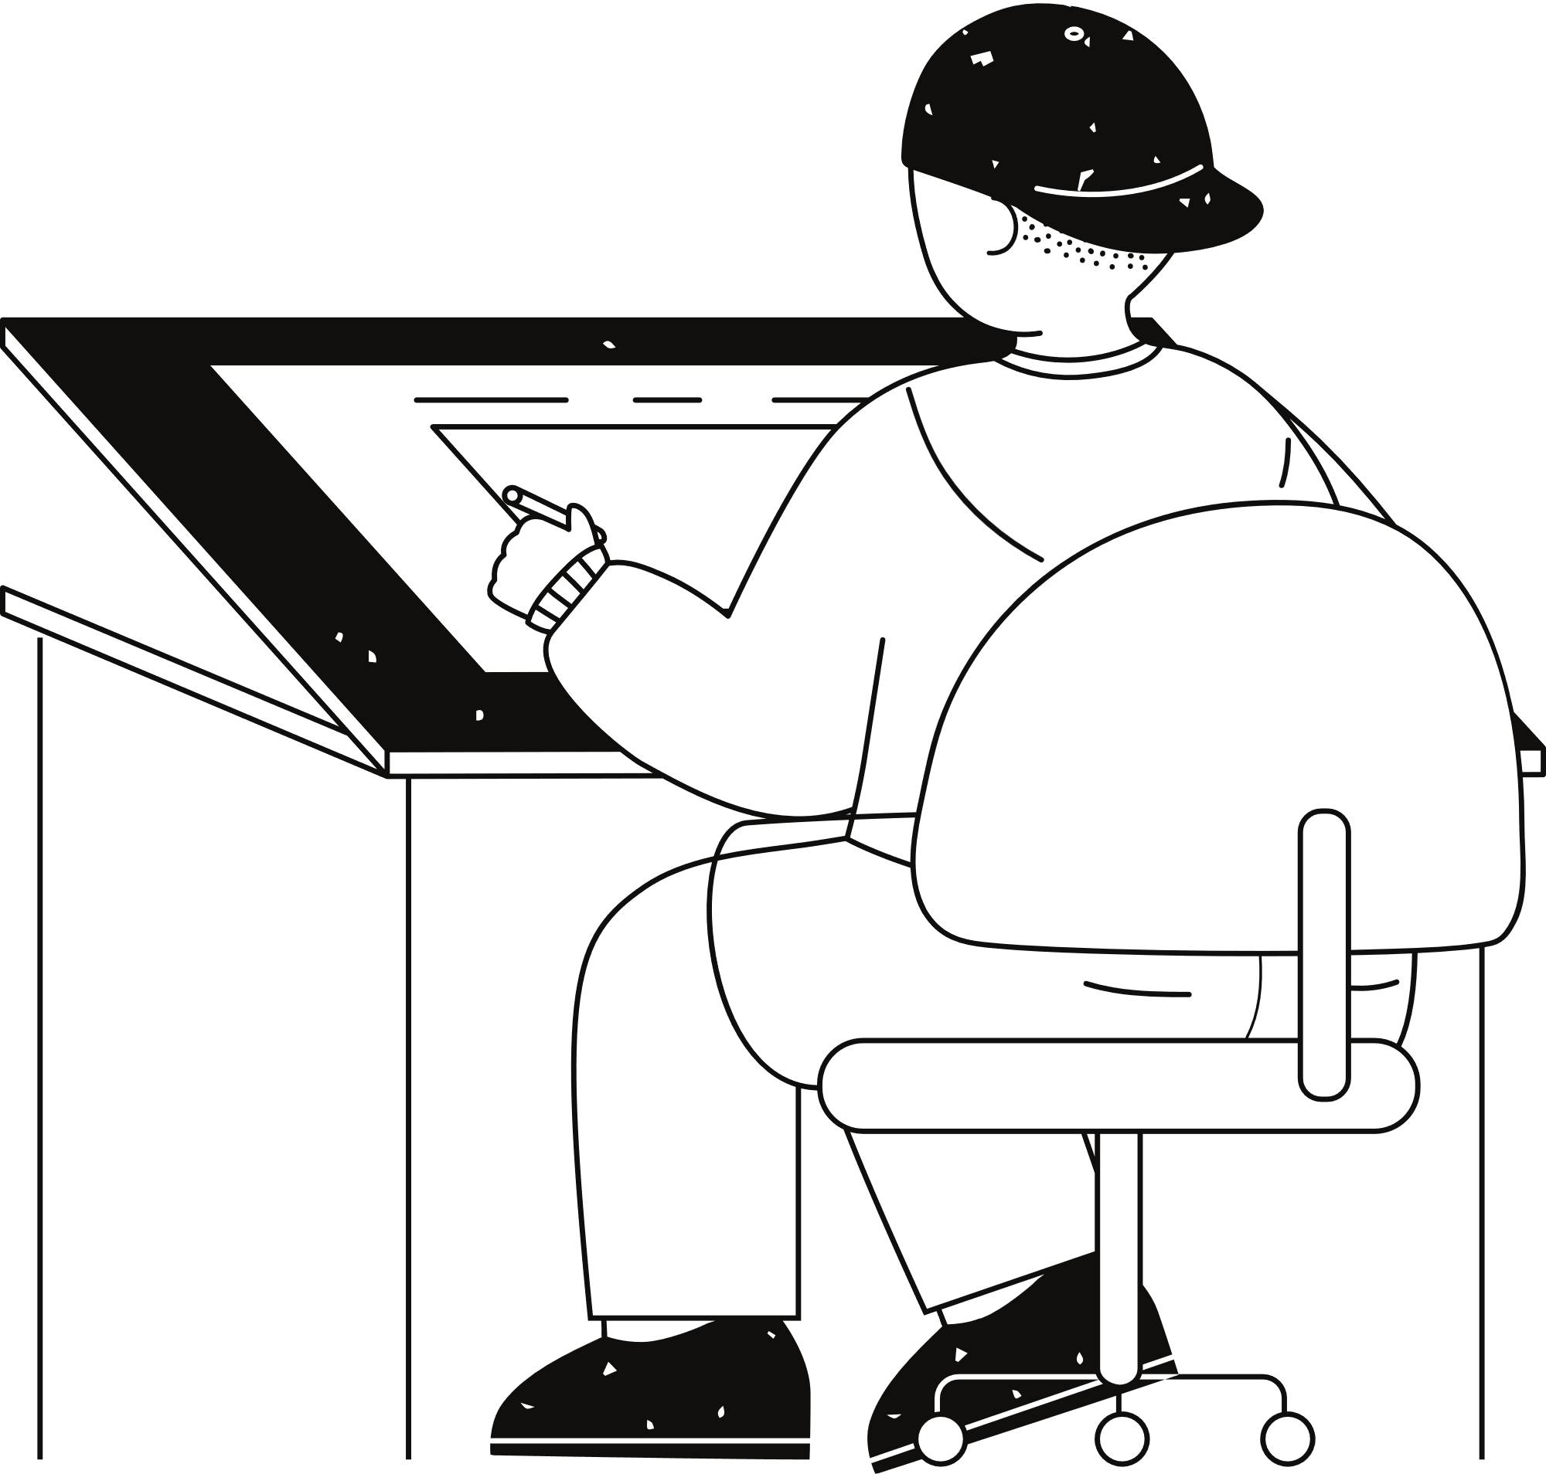
Team Collaboration
Github for version control
Online communication
Gather for collaborative coding

Slide 32



Team Collaboration
Peiyu Duan
Tong Li
AI interface
Backend Design
DataBase Design
AI interface
Backend Design
DataBase Design
Xuanhe Yang
Fubin Chen
Frontend Design
Speech Recognition
Report Design
Frontend Design
Speech Recognition
Slide Design

Slide 33
Part V
Key Challenges Solutions

Slide 34
Key Challenges
AI Evaluation
AI Interface
Initially, we integrated GPT for generating responses. However, GPT's replies were not child-friendly, often overly verbose, and failed to focus on key teaching objectives.
After deciding not to use GPT, we faced the challenge of coordinating multiple AI systems for a single response. Managing and processing evaluation results from various AI models became a critical issue.
Speech Recognition
Feature Integration
Initially, our speech recognition system failed to deliver results to the frontend in real-time, and the recognition accuracy was very low.
Initially, each team member developed their own features independently. Later, merging all functionalities into a cohesive system presented significant challenges.

Slide 35
Key Solution
AI Evaluation
AI Interface
We abandoned the approach of relying solely on GPT for responses. Instead, we integrated multiple AI interfaces, such as sentiment analysis, to ensure that the AI's replies are both child-friendly and educationally meaningful.
To enhance collaboration among multiple AI systems, we organized several offline coding sessions. This approach significantly accelerated progress and improved integration efficiency.
Speech Recognition
Feature Integration
We ensured fixed parameters for accuracy and modified the logic to send real-time WebSocket outputs as text to the frontend.
Through offline collaborative coding sessions, we efficiently completed the integration of all features, ensuring seamless functionality.

Slide 36

Demo
Watch
Our Demo!

Slide 37







Thank you !
Team 08

